Slide 1
Hayak.com
INFO 445
Joe Motto
Jorge Torres
Allen Cho
EuiYul Song

Slide 2
What is Hayak.com?
Hayak is a travel booking website, providing consumers with tools to book flights, hotels, and car rentals.
Hayak compares travel websites to provide consumers the cheapest travel options.
Our database connects the data from the travel websites with the available flights, hotels and rentals to present the customer with the best deals.
Stakeholders: Travel Websites
Users: Travelers

Slide 3
Tables
Vehicle
VIN
Make
Model
Color
Year
Beginning Mileage
Customer
First Name
Last Name
DOB
Website
Name
Descr
Booking (Order)
Date / Time
Cost
Flight
Name
Descr
Hotel
Name
Descr
Location (Street, City, State, Country)

Slide 4
Draft ERD

Slide 5
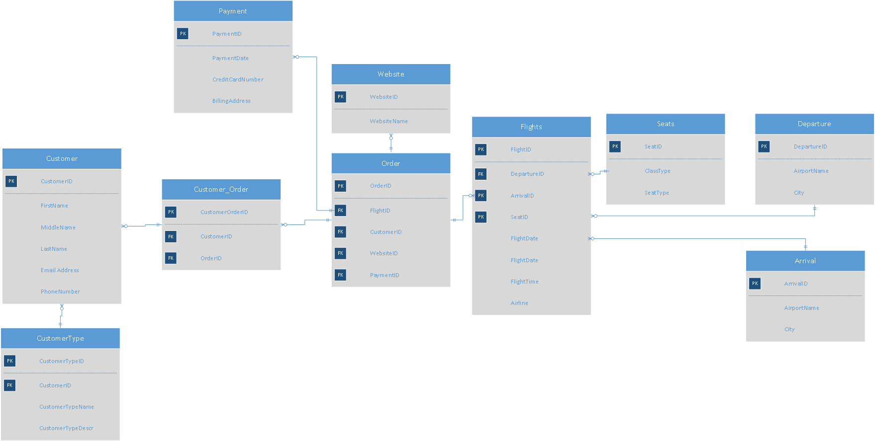

Slide 6
Database Lifecycle
Resolve many to many’s and rethinking some relationships (e.g. FLIGHT, SEAT, BOARDING; ROOM, HOTEL, CUSTOMER_HOTEL).
Allow tracking of begin dates and end dates (datetimes for flights) for Flights.
Fix missing Foreign Keys / Foreign Keys in wrong direction.
Allow tracking of departure and arrival airports without storing duplicate data and having a table for each.
Notes:
There is a problem with FLIGHT having SeatID as a PK; obviously one FLIGHT has many SEATs so this is M:M...I still think a BOARDING is tied to a FLIGHT and SEAT so the M:M associative entity here may be BOARDING.
CUSTOMER_HOTEL probably has a relationship with ROOM as opposed to HOTEL . ROOM will be defined by HotelID as a FK. The resulting table can be called CUSTOMER_ROOM (which should have a beginDate and EndDate).
Missing Foreign Key in the Parent table
DEPARTURE & ARRIVAL are problematic because it appears that every single 'take-off' from SeaTac for example will result in duplicate data being stored

Slide 8
Revised ERD

Slide 9
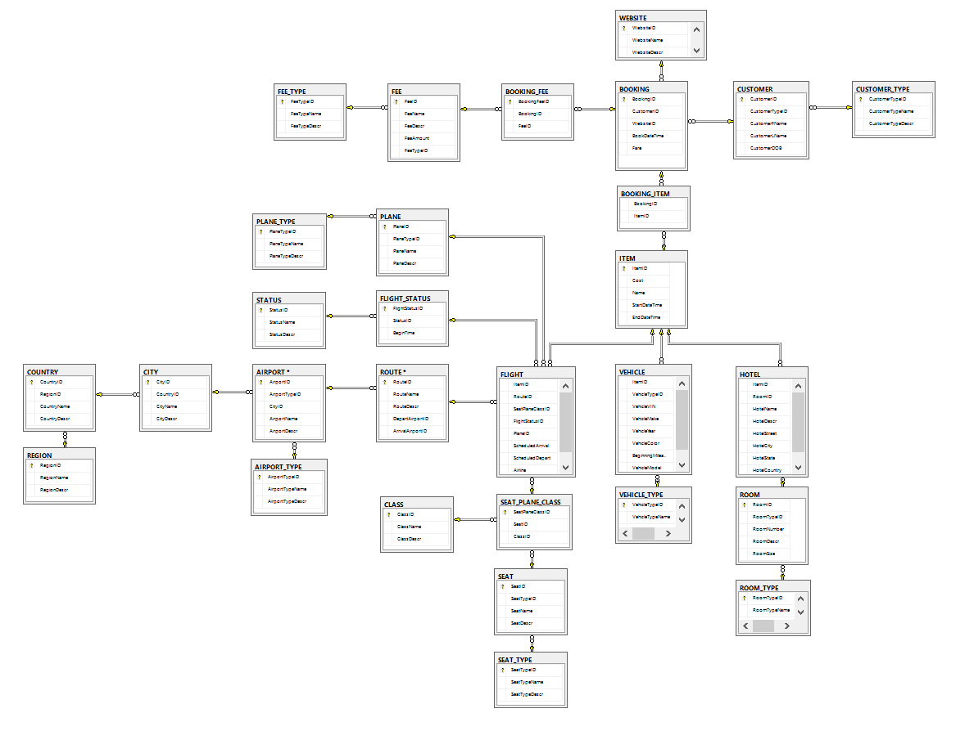

Slide 10
Overcome Challenges
Remodeled our ERD
Figured out how to use Subtype and Supertype
Implemented with OLTP
Synthetic Transaction
Nested Stored Procedure
Computed Column

Slide 11
Database code Examples (Table Creation)
CREATE TABLE REGION(
RegionID int identity (1,1) primary key not null,
RegionName varchar(50) not null,
RegionDescr varchar(100)
)
CREATE TABLE COUNTRY (
CountryID int identity (1,1) primary key not null,
RegionID int foreign key references REGION(RegionID),
CountryName varchar(50) not null,
CountryDescr varchar(100)
)
CREATE TABLE WEBSITE(
WebsiteID int identity (1,1) primary key not null,
WebsiteName varchar(50) not null,
WebsiteDescr varchar(100)
)
CREATE TABLE AIRPORT_TYPE(
AirportTypeID int identity (1,1) primary key not null,
AirportTypeName varchar(50) not null,
AirportTypeDescr varchar(100)
)
CREATE TABLE AIRPORT(
AirportID int identity (1,1) primary key not null,
AirportTypeID int foreign key references AIRPORT_TYPE(AirportTypeID) not null,
CityID int foreign key references CITY(CityID) not null,
AirportName varchar(50) not null,
AirportDescr varchar(100)
)

Slide 12
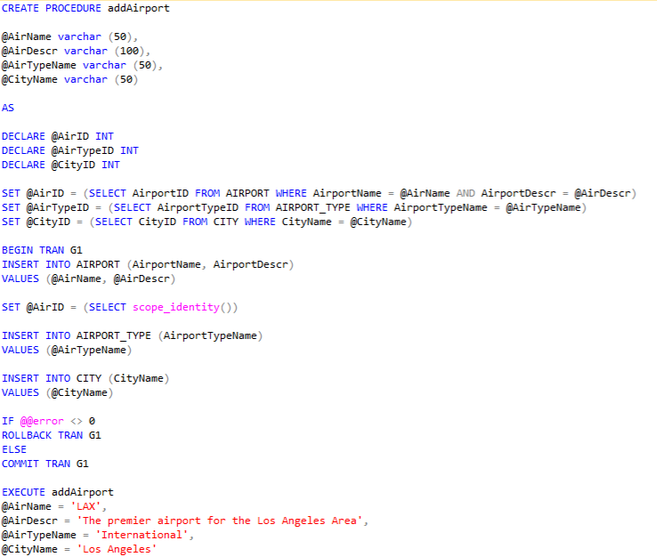
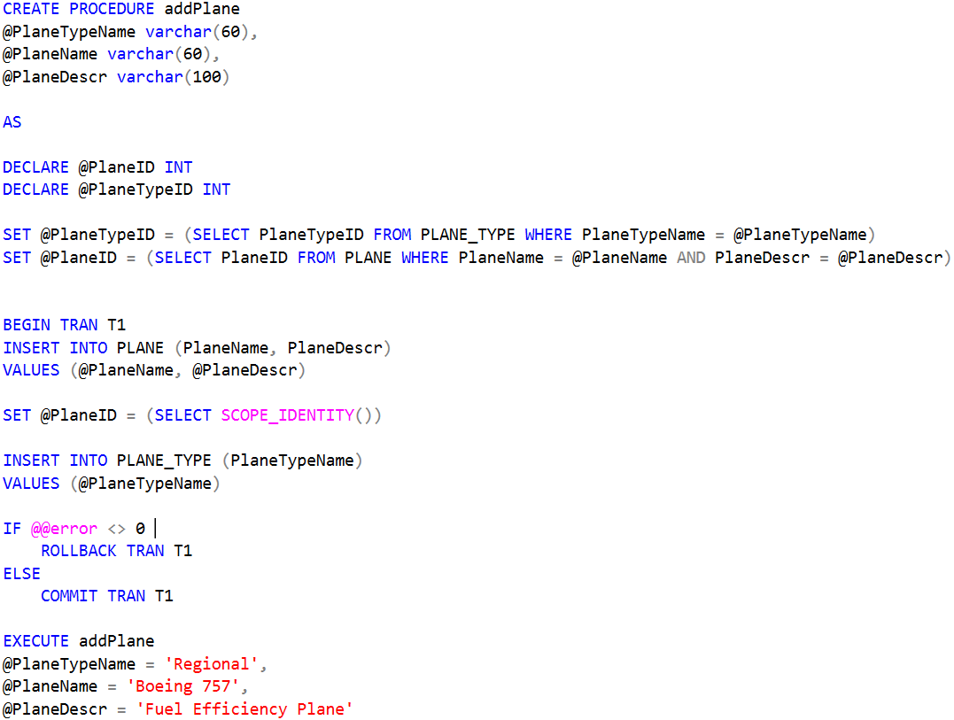
Database Code Example (Stored Procedure)

Slide 13
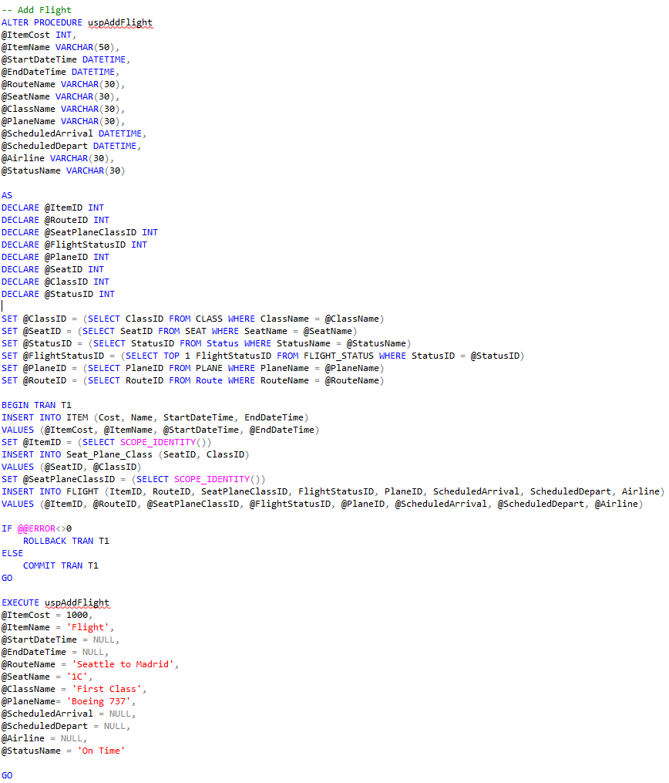
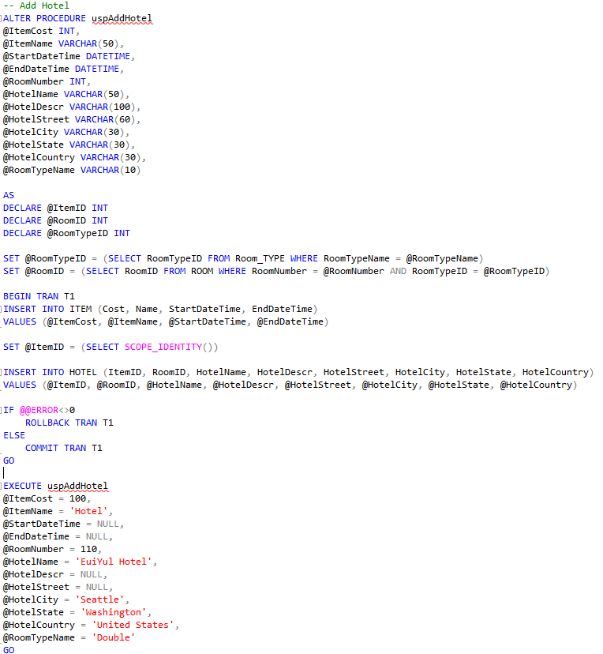
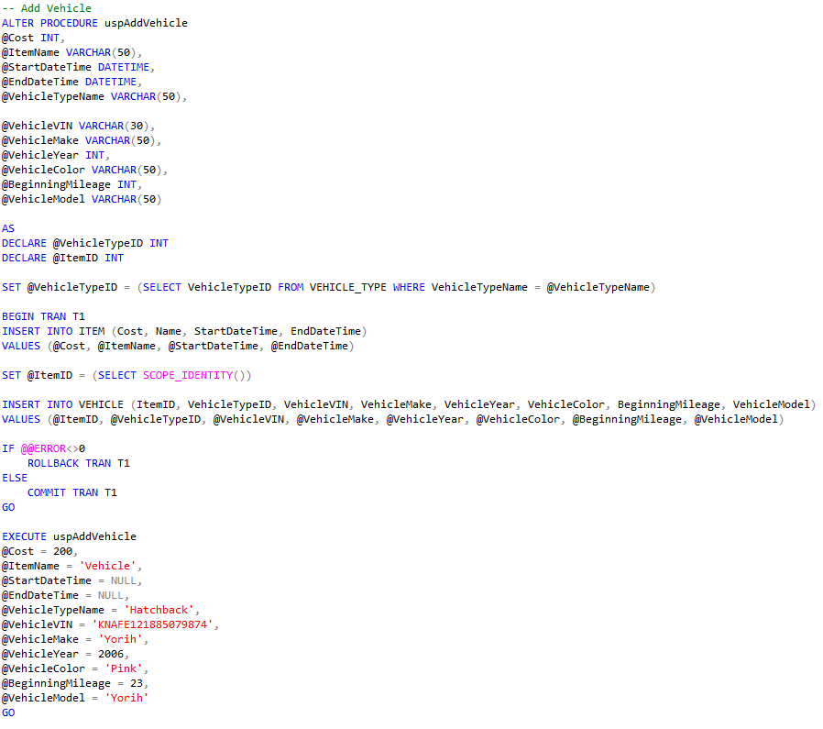
SuperType and SubType (Stored Procedures)
Notes:
-- Add Hotel
EXECUTE uspAddHotel
@ItemCost = 100,
@ItemName = 'Hotel',
@StartDateTime = NULL,
@EndDateTime = NULL,
@RoomNumber = 110,
@HotelName = 'Greg Hotel',
@HotelDescr = NULL,
@HotelStreet = NULL,
@HotelCity = 'Seattle',
@HotelState = 'Washington',
@HotelCountry = 'United States',
@RoomTypeName = 'Double'
GO
-- Add Vehicle
EXECUTE uspAddVehicle
@Cost = 200,
@ItemName = 'Vehicle',
@StartDateTime = NULL,
@EndDateTime = NULL,
@VehicleTypeName = 'Hatchback',
@VehicleVIN = 'KNAFE121885079874',
@VehicleMake = 'Greg',
@VehicleYear = 2006,
@VehicleColor = 'Pink',
@BeginningMileage = 23,
@VehicleModel = 'Greg'
GO
--Add Flight
EXECUTE uspAddFlight
@ItemCost = 1000,
@ItemName = 'Flight',
@StartDateTime = NULL,
@EndDateTime = NULL,
@RouteName = 'Seattle to Madrid',
@SeatName = '1C',
@ClassName = 'First Class',
@PlaneName= 'Boeing 737',
@ScheduledArrival = NULL,
@ScheduledDepart = NULL,
@Airline = 'Greg Airline',
@StatusName = 'On Time'
GO

Slide 14
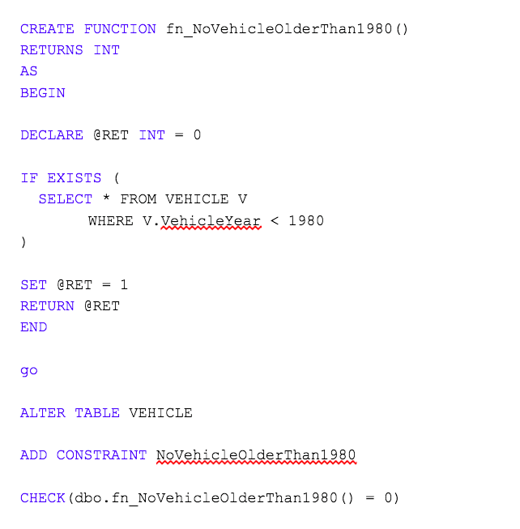
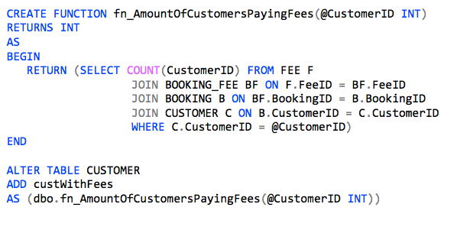
Code Examples (Business Rule and Computed Column)

Slide 15
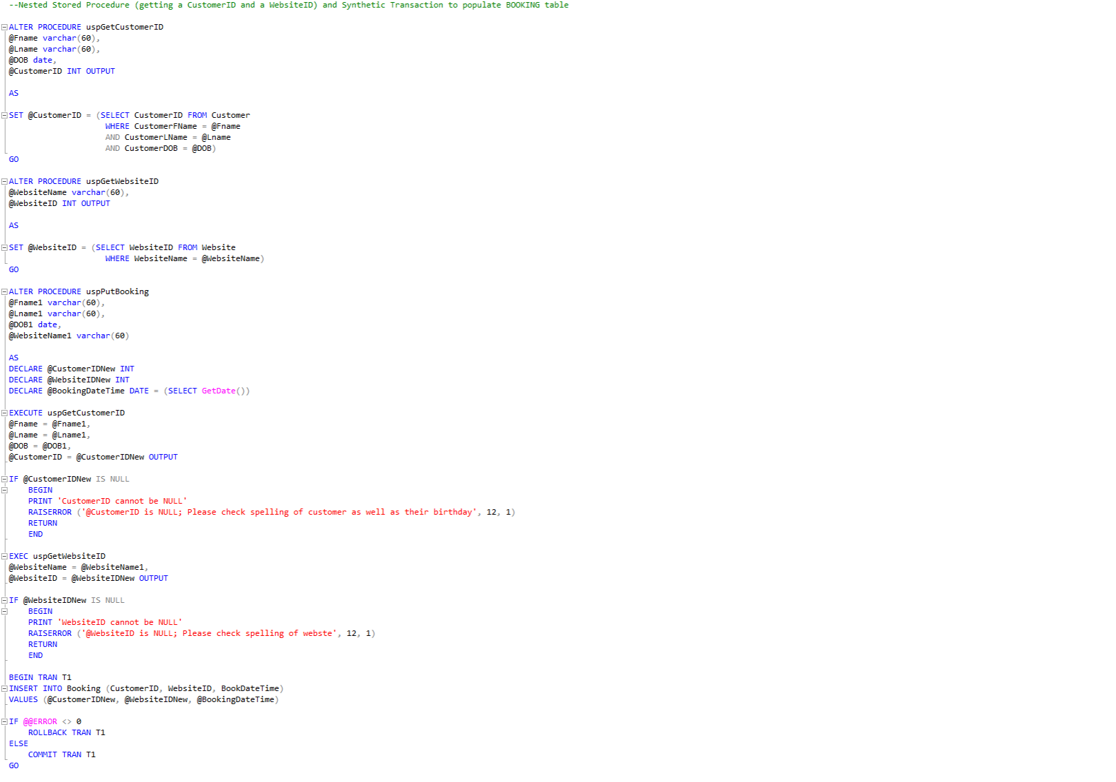
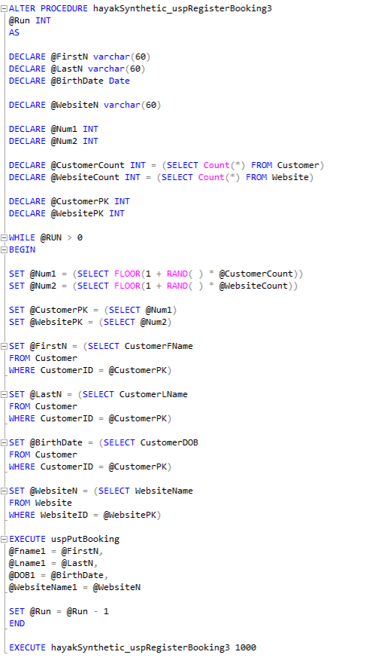
Database Code Example (Synthetic Tran)
Notes:
-- Synthetic transaction to populate booking
EXECUTE hayakSynthetic_uspRegisterBooking3 3

Slide 16
Web Front-End

Slide 17
Thank you!

